Slide 1
Data Science Training
July 2022

Slide 2





Agenda
Data Science and Python Introduction
Data Preparation
Exploratory Data Analysis
Data Visualization
Feature Engineering & Selection
Supervised Learning
Neural Networks
Unsupervised Learning
Tuning, Validation & Testing
Final Exam

Slide 3
Data Science Training
Feature Engineering & Selection
July 2022

Slide 4
Agenda
01
Introduction
02
Feature Engineering
03
Feature Selection
04
Practice

Slide 5
“Weak” Data
Clean, well-represented data may not be sufficient to exploit the full potential from available data, thus what else can be done to be even more effective in Data Analysis process?
Feature Engineering. Transform your features in order to:
Make your dataset compatible with the machine learning algorithm requirements
Improve the performance of the machine learning algorithm
Feature Selection. Reduce dimensionality of your dataset removing irrelevant and redundant features.
5

Slide 6
Agenda
01
Introduction
02
Feature Engineering
03
Feature Selection
04
Practice

Slide 7
Encoding
Encoding is the process of converting data into a format required for a number of information processing needs. There are different kind of methods (encodings) that map each category to an integer/vector of integer.
Jobs
1
2
3
4
Introduces ordering in our dataset, (e.g. 2 is greater than 1 and so on…) which could make no sense
Types of Encoding
An integer per each class
Jobs
[0, 0, 1]
[0, 1, 0]
[0, 1, 1]
[1, 0, 0]
Jobs
Gardner
Plumber
Data scientist
Teacher
1
Label Encoding
Subsampling columns as well as observations can possibly break the binary features
A binary number per each class
2
Binary Encoding
Jobs
[1, 0, 0, 0]
[0, 1, 0, 0]
[0, 0, 1, 0]
[0, 0, 0, 1]
3
One-hot Encoding
Only one “hot” bit per each class
For high cardinality, the feature space can blow up quickly
7

Slide 8

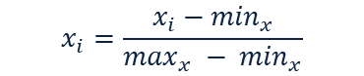
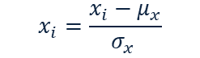
Normalization
Normalization is often performed on data to remove amplitude variation and only focus on the underlying distribution shape. Many algorithms work well without normalization, but in some cases algorithms return incorrect results if feature normalization is not performed.
Min-max normalization
Z-score normalization
Decimal scaling
$$x_{i}=\frac{x_{i}−\min_{x}}{\max_{x} − \min_{x}}$$
$$x_{i}=\frac{x_{i}−μ_{x}}{σ_{x} }$$
$$x_{i}=\frac{x_{i}}{{10}^{j}}$$
VAR | MIN_MAX | Z_NORM | DEC_SC
746 | 0.7413 | 0.9289 | 0.7467
887 | 0.8855 | 1.4504 | 0.8879
605 | 0.5971 | 0.4074 | 0.6056
806 | 0.8027 | 1.1508 | 0.8068
30 | 0.0092 | -1.7193 | 0.0300
973 | 0.9734 | 1.7685 | 0.9740
112 | 0.0930 | -1.4160 | 0.1121
272 | 0.2566 | -0.8243 | 0.2723
482 | 0.4714 | -0.0475 | 0.4825
984 | 0.9847 | 1.8092 | 0.9850
VAR SUMMARY
count | 1018
mean | 494.8
std | 271.7
min | 21.3
Q1 | 258.5
Q2 | 521.5
Q3 | 689.5
max | 987.8
8

Slide 9
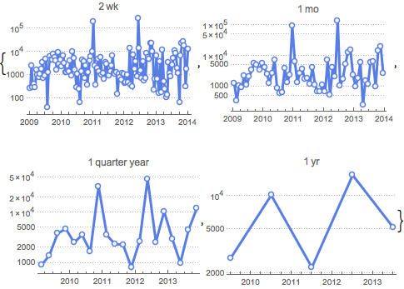
Aggregation and Disaggregation of KPIs
Make the data consistent on all dimensions:
Time intervals (month, weeks, days, hours, etc.)
Geographical reference (city, region, county, etc.)
Referred period (quarter, half, year, etc.)
Example of temporal aggregation
Example of country disaggregation
9

Slide 10





Create New Features
Feature engineering is the process of using domain knowledge of the data to create features that let machine learning algorithms work better. The features in your data will influence the results you are going to achieve and their quality and quantity will have great influence on whether the model will be good or not.
Churn Prediction
Sales Forecasting
Traffic Forecasting
Marketing Mix Model
Days from previous “bill shock” event for the customer
Amount of items sold in the previous 1, 2, …, n days from observation
Qualification of weekday: bank holidays, pre-bank holiday, working day
“Big-event” days: black Friday, cyber Monday, etc.
10

Slide 11
Agenda
01
Introduction
02
Feature Engineering
03
Feature Selection
04
Practice

Slide 12
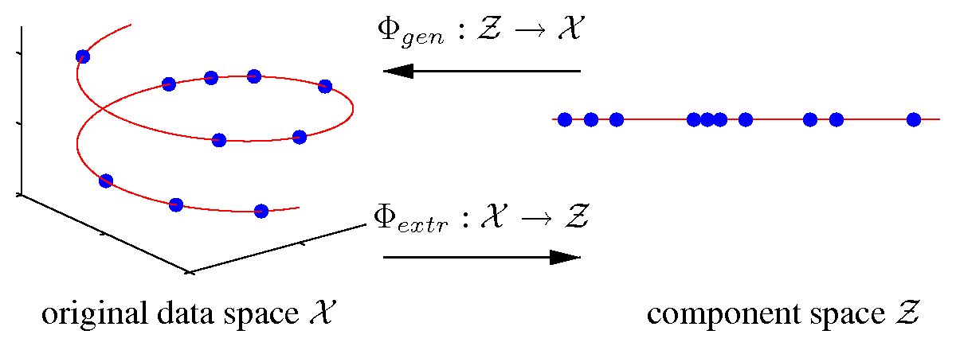
Dimensionality Reduction
In machine learning and statistics, dimensionality reduction is the process of reducing the number of random variables under consideration by obtaining a set of principal variables. It can be divided into feature extraction and feature selection.
Feature Extraction
Feature Selection
Build derived values (features) intended to be informative and non-redundant, facilitating the subsequent learning and generalization steps.
Selecting a subset of relevant features (variables, predictors) for use in model construction.
We will explore this method in later sections.
Height | Weight | Age | Interest
166 | 50 | 23 | Soccer
156 | 54 | 65 | F1
189 | 90 | 22 | Soccer
177 | 68 | 24 | Soccer
165 | 78 | 63 | F1
156 | 45 | 50 | F1
12

Slide 13
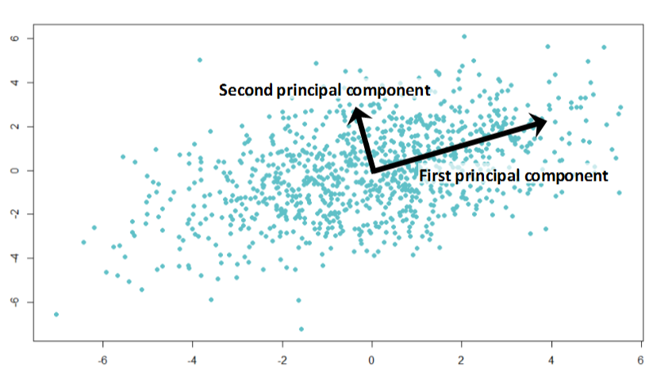
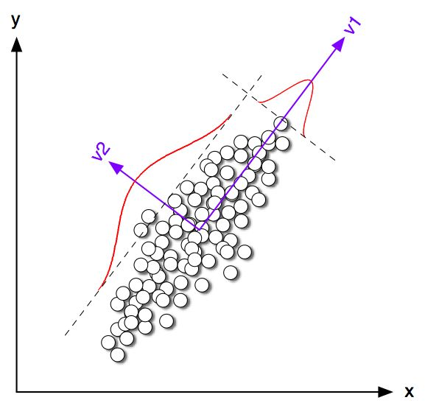
Principal Components Analysis (PCA)
Data points with n dimensions can be represented by n-dimensional vectors in a n-dimensional vector space. Principal Component Analysis (PCA) is to extract a new set of basis to represent the n-dimensional vectors. The axes that form the new set of basis are ranked in the order of importance by the amount of information (variance) from each vector that the new axes contains when vectors project onto them.
e₁
Projection onto 1st PC
Projection onto 2nd PC
e₂
e₁
e₂
13

Slide 14
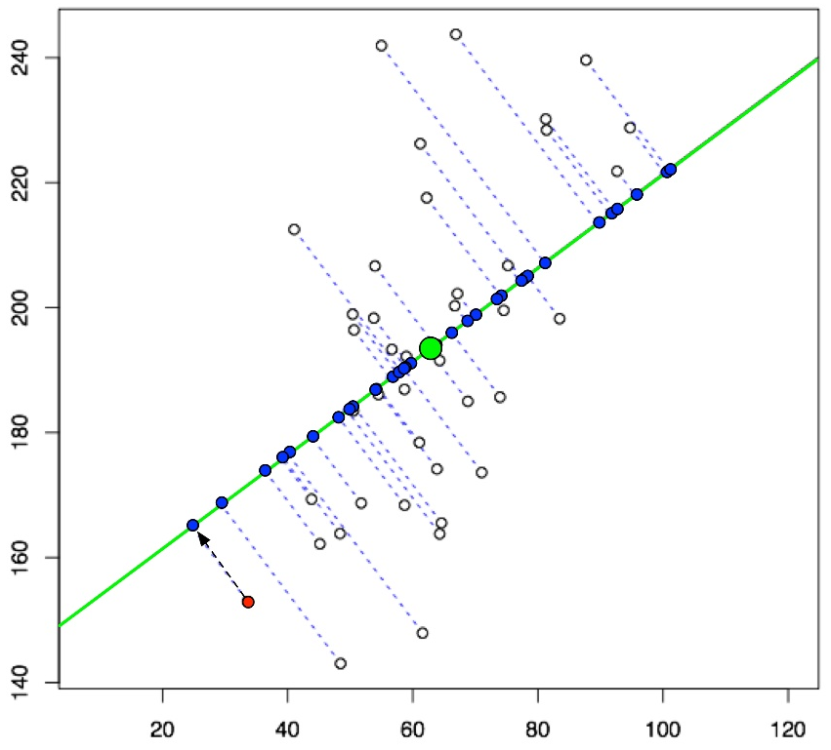
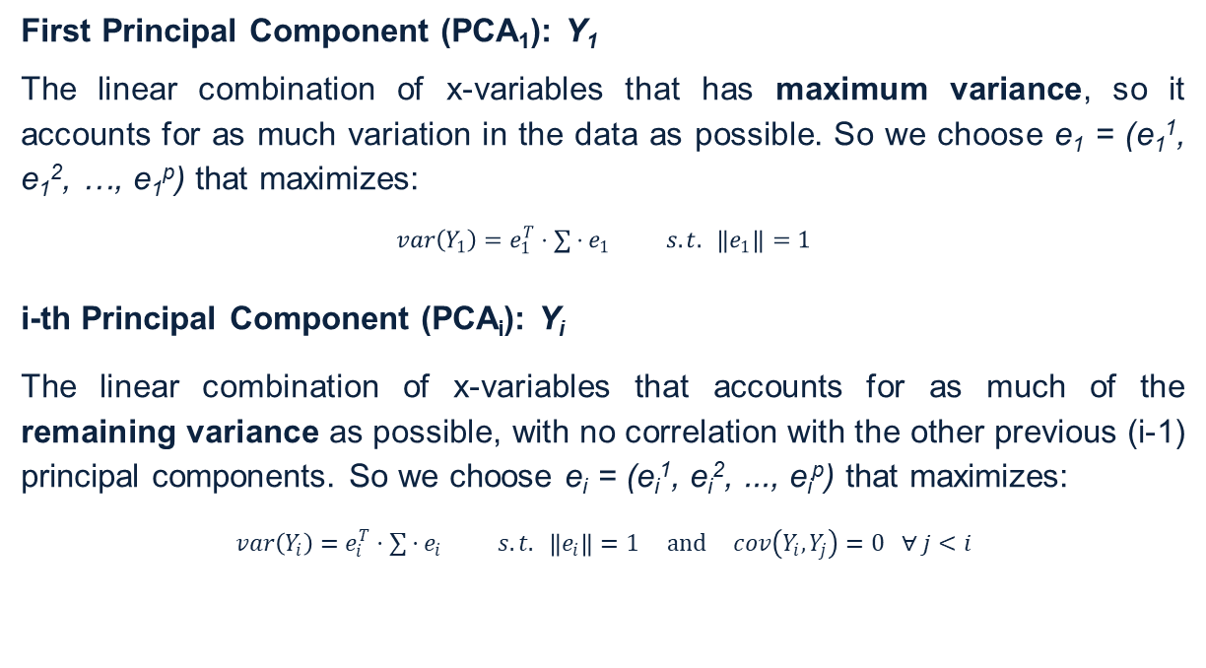
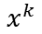
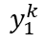
PCA procedure
Let’s suppose out dataset is in form of an (n x p) numerical matrix X with var-cov matrix ∑.
Mathematically, the PC transformation is defined by a set of p-dimensional vectors of weights e_{i} = (e_{i}¹, e_{i}², …, e_{i}^{p}) that map each row vector x of X to a new vector of principal component scores Y_{i} = (y_{i}¹, y_{i}², …, y_{i}^{n}), such that the individual variables of Y considered over the data set successively inherit the maximum possible variance from x.
First Principal Component (PCA₁): Y₁
The linear combination of x-variables that has maximum variance, so it accounts for as much variation in the data as possible. So we choose e₁ = (e₁¹, e₁², …, e₁^{p}) that maximizes:
$$var\left(Y_{1}\right)=e_{1}^{T}⋅∑{⋅e}_{1} s.t. \left\|e_{1}\right\|=1$$
i-th Principal Component (PCA_{i}): Y_{i}
The linear combination of x-variables that accounts for as much of the remaining variance as possible, with no correlation with the other previous (i-1) principal components. So we choose e_{i} = (e_{i}¹, e_{i}², ..., e_{i}^{p}) that maximizes:
$$var\left(Y_{i}\right)=e_{i}^{T}⋅∑{⋅e}_{i} s.t. \left\|e_{i}\right\|=1 and cov\left(Y_{i}, Y_{j}\right)=0 ∀ j<i$$
$$y_{1}^{k}$$
e₁
$$x^{k}$$
14

Slide 15
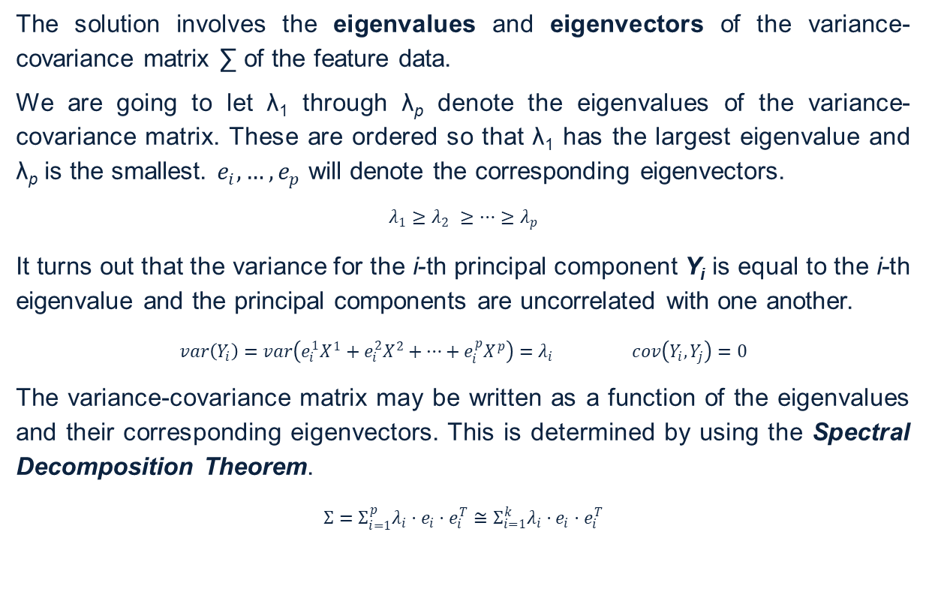
PCA: how to find the coefficients
The solution involves the eigenvalues and eigenvectors of the variance-covariance matrix ∑ of the feature data.
We are going to let λ₁ through λ_{p} denote the eigenvalues of the variance-covariance matrix. These are ordered so that λ₁ has the largest eigenvalue and λ_{p} is the smallest. $e_{i},…,e_{p}$ will denote the corresponding eigenvectors.
$$λ_{1}≥λ_{2} ≥…{≥λ}_{p}$$
It turns out that the variance for the i-th principal component Y_{i} is equal to the i-th eigenvalue and the principal components are uncorrelated with one another.
$$var\left(Y_{i}\right)=var\left(e_{i}^{1}X^{1}+e_{i}^{2}X^{2}+…+e_{i}^{p}X^{p}\right)=λ_{i} cov\left(Y_{i},Y_{j}\right)=0$$
The variance-covariance matrix may be written as a function of the eigenvalues and their corresponding eigenvectors. This is determined by using the Spectral Decomposition Theorem.
$$Σ=Σ_{i=1}^{p}{λ_{i}⋅e}_{i}⋅e_{i}^{T}≅Σ_{i=1}^{k}{λ_{i}⋅e}_{i}⋅e_{i}^{T}$$
To obtain the simplest possible interpretation, we want k to be as small as possible
PCA
To avoid loss of
information, we
want the proportion of variation explained by the first k principal components to be large
15

Slide 16
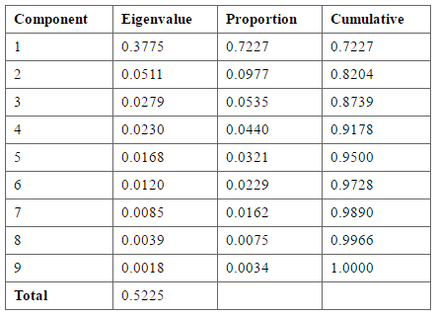
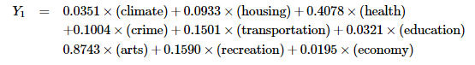
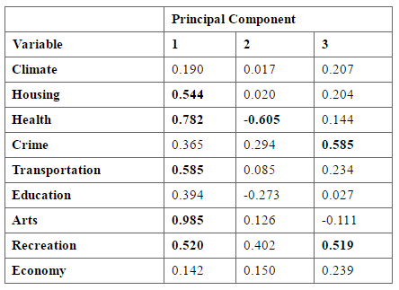
PCA: Interpreting the Principal Components
We will use the Places Rated Almanac data (Boyer and Savageau) which rates 329 communities according to nine criteria: Climate and Terrain, Housing, Health Care & Environment, Crime, Transportation, Education, The Arts, Recreation, Economics.
1
Determine how many principal components should be considered
2
Compute the principal component scores
3
Compute the correlations between variables and PC and interpret each component
NB: Magnitudes of the coefficients give the contributions of each variable to that component. However, the magnitude of the coefficients also depend on the variances of the corresponding variables.
16

Slide 17
Other Feature Selection Methods
Variance Threshold: it removes all features whose variance doesn’t meet a threshold.
Univariate Feature Selection: it works by selecting the best features based on univariate statistical tests.
Feature Selection with a Decision Tree: it selects the features that are chosen at the top nodes of a decision tree.
Recursive Feature Elimination: it considers smaller and smaller feature sets by removing the feature of least importance to the model with each iteration.
1
2
17

Slide 18
Agenda
01
Introduction
02
Feature Engineering
03
Feature Selection
04
Practice

Slide 19

Launch Jupyter Notebook through Anaconda Navigator
Open Windows search bar again and run Anaconda Navigator. Once the application has started, launch Jupyter Notebook.
19

Slide 20
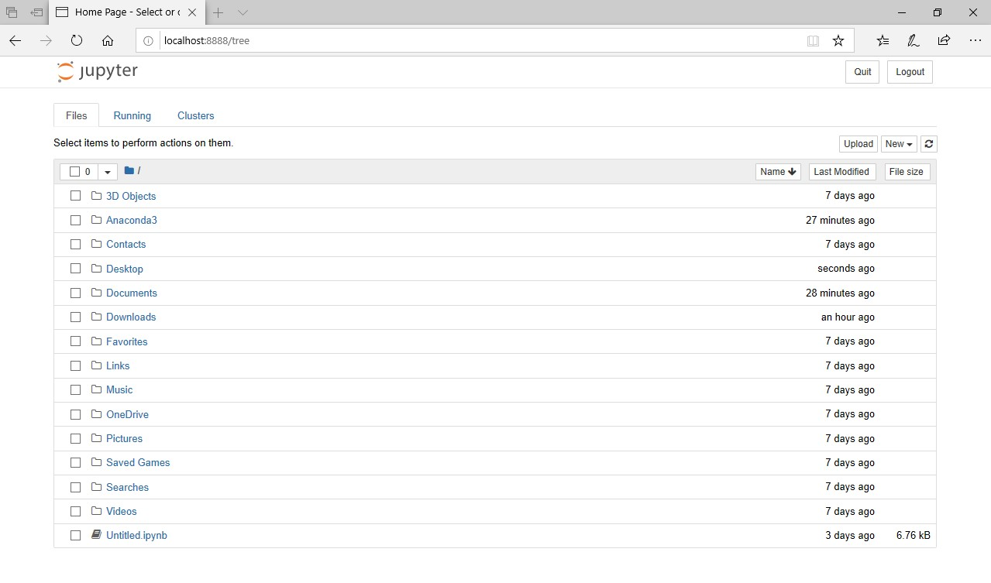
Open ► Day 5 - Feature Engineering & Selection.ipynb
If you see a browser page as the example below, Jupyter Notebook is correctly running on the machine.
20

